Slide 1
Review Problems
Section 7:
3/21-23/2017

Slide 2

Lens Problems: 1

Slide 3
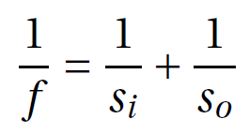
Lens Problems: 1

Slide 4
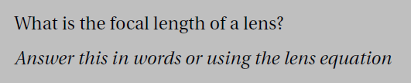
Lens Problems: 2

Slide 5
Lens Problems: 2
On board

Slide 6
Lens Problems: 3

Slide 7
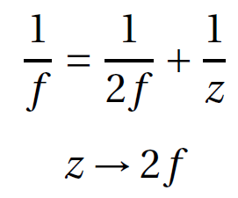
Lens Problems: 3

Slide 8
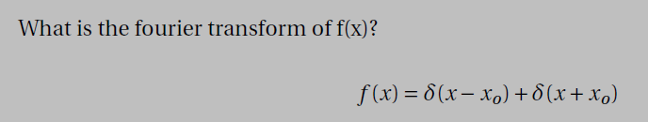
Fourier Transforms : 1

Slide 9
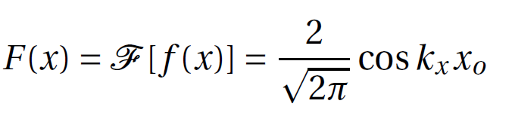
Fourier Transforms : 1

Slide 10
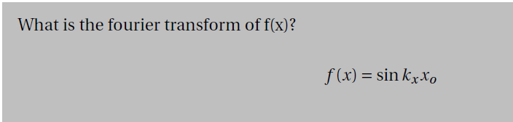
Fourier Transforms : 2

Slide 11
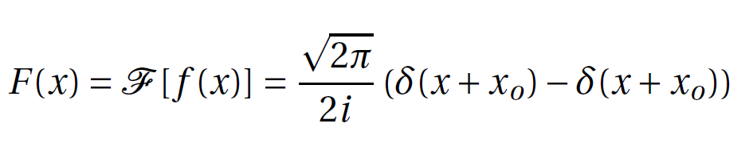
Fourier Transforms : 2

Slide 12

Fourier Transforms : 3

Slide 13
Fourier Transforms : 3
Fourier Transforms from –f to f!

Slide 14
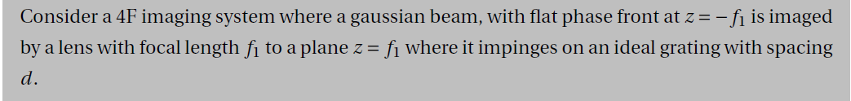
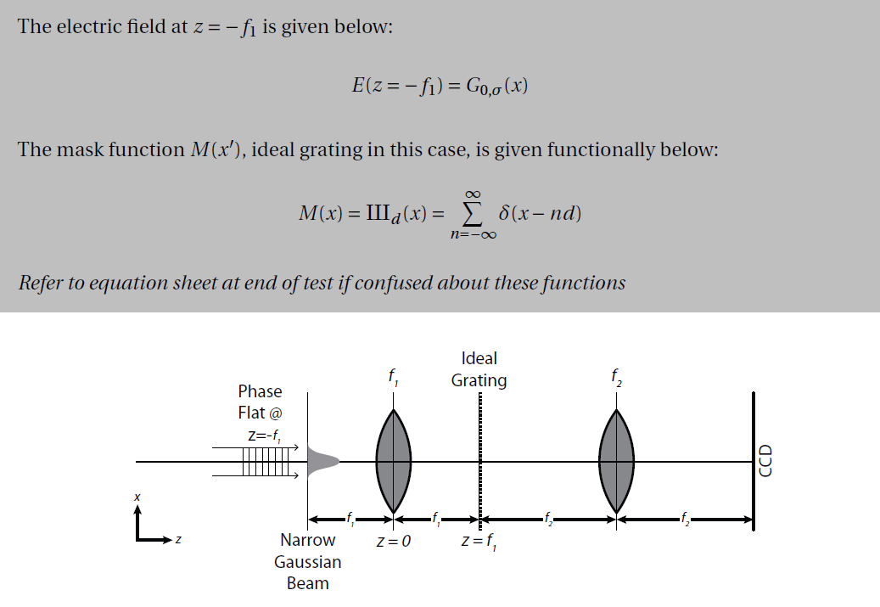
Fourier Transforms : 4

Slide 15
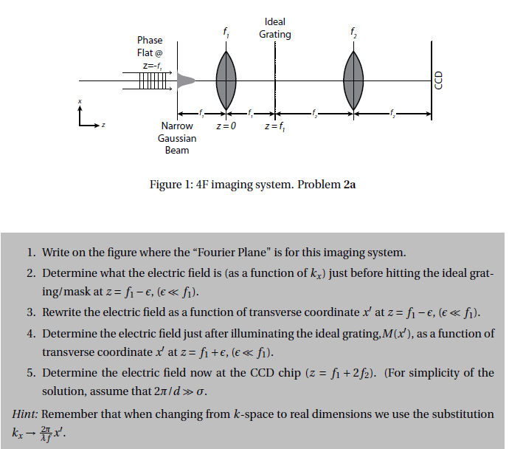
Fourier Transforms : 4

Slide 16
Fourier Transforms : 4

Slide 17
Fourier Transforms : 4

Slide 18
Fourier Transforms : 4

Slide 19
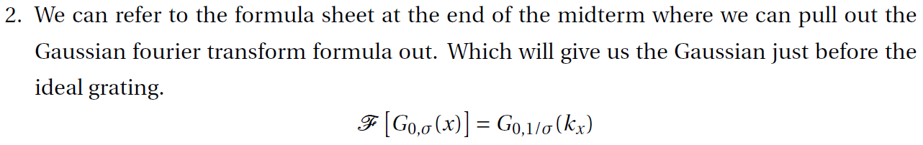
Fourier Transforms : 4

Slide 20
Fourier Transforms : 4

Slide 21
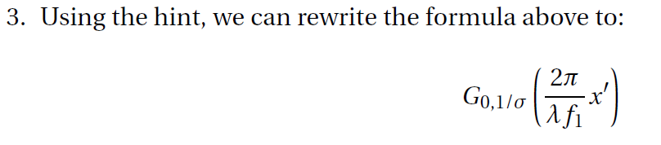
Fourier Transforms : 4

Slide 22
Fourier Transforms : 4

Slide 23
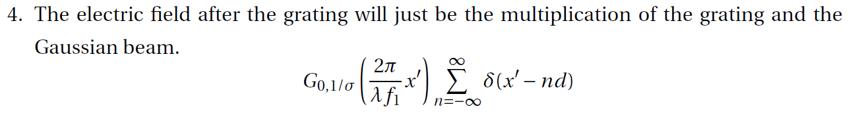
Fourier Transforms : 4

Slide 24
Fourier Transforms : 4

Slide 25
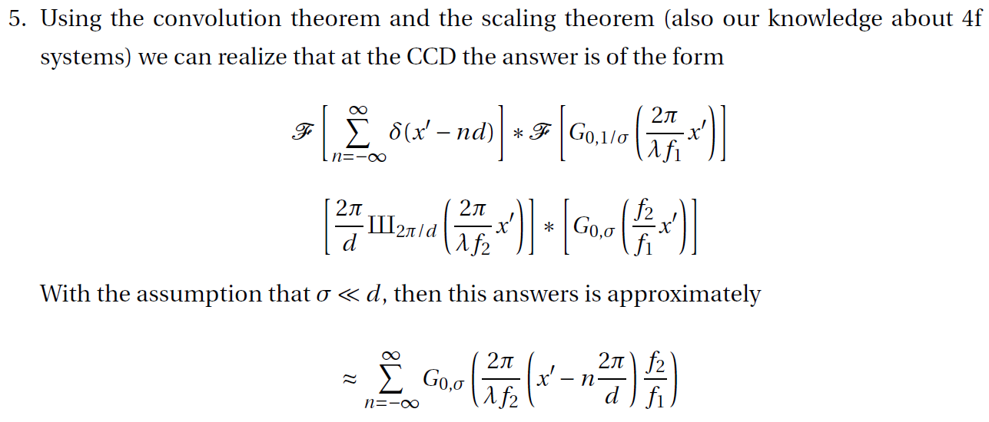
Fourier Transforms : 4

Slide 26
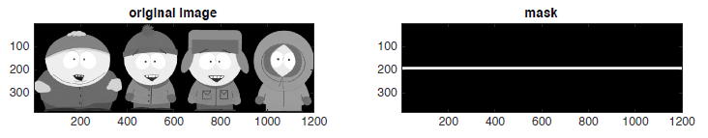
Fourier Filters (By Eye): 1

Slide 27
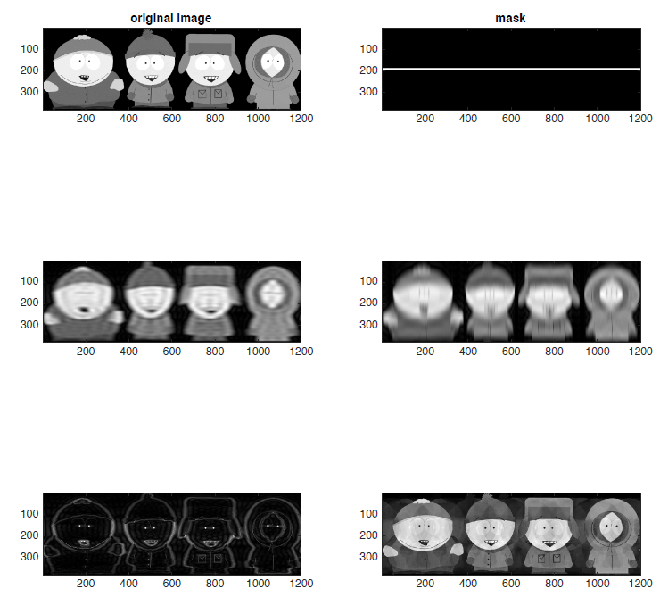
Fourier Filters (By Eye)

Slide 28
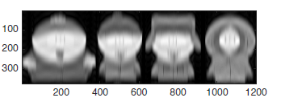
Fourier Filters (By Eye):1

Slide 29
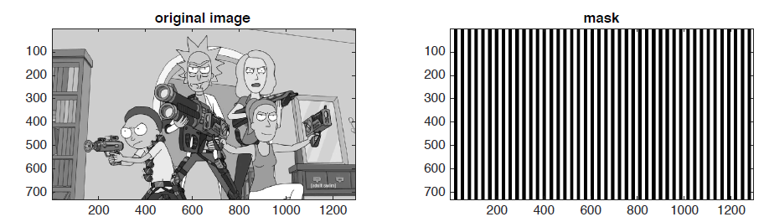
Fourier Filters (By Eye): 2

Slide 30
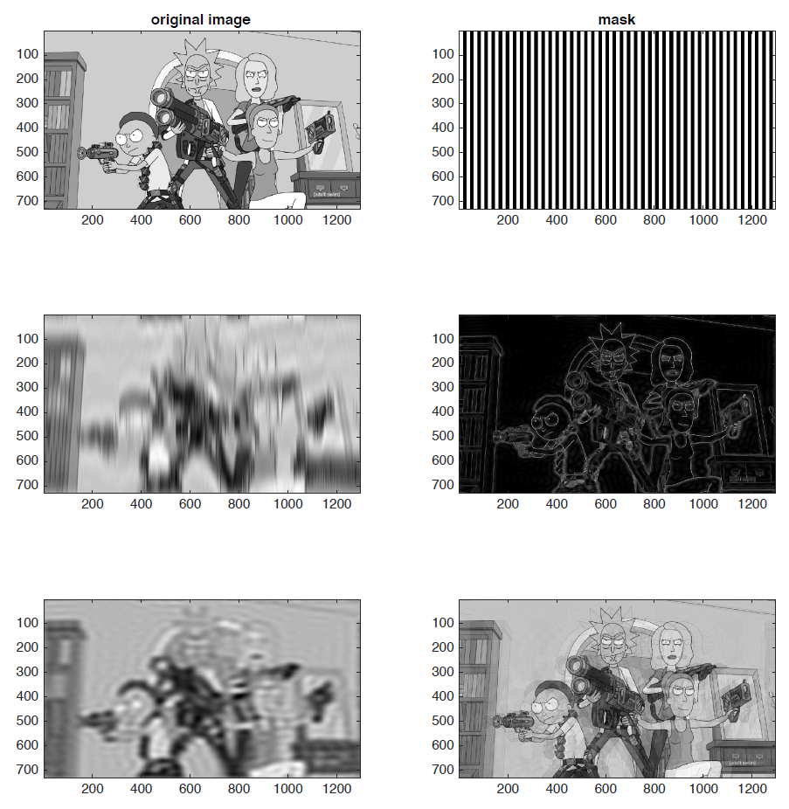
Fourier Filters (By Eye)

Slide 31
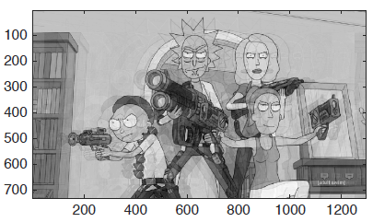
Fourier Filters (By Eye):2

Slide 32
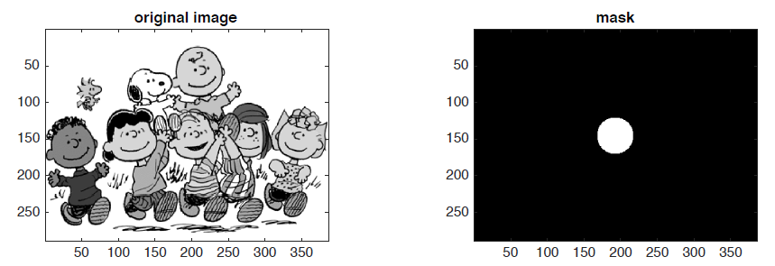
Fourier Filters (By Eye): 3

Slide 33
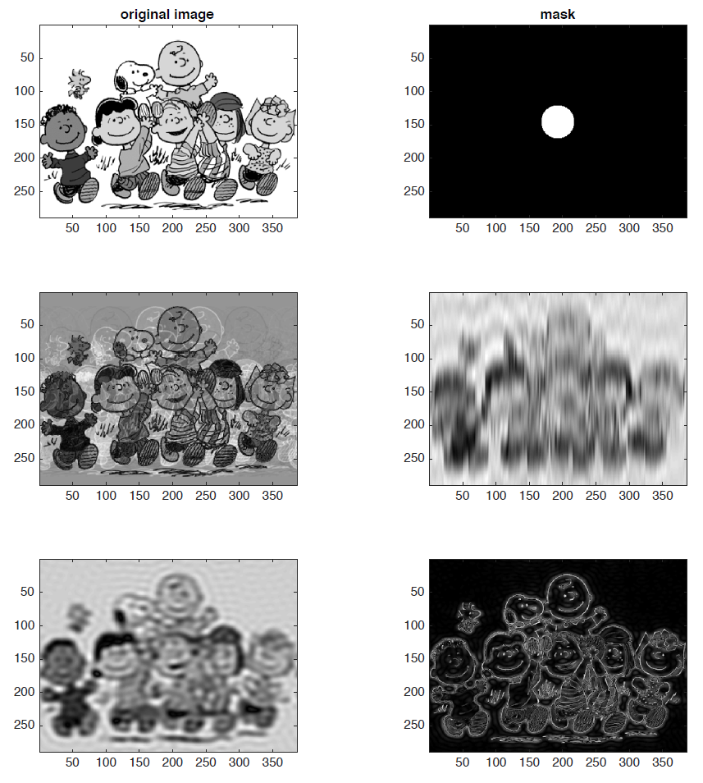
Fourier Filters (By Eye)

Slide 34
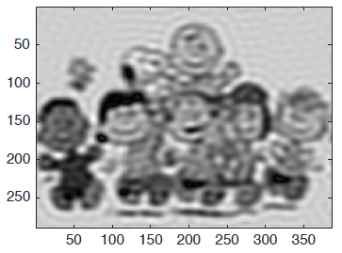
Fourier Filters (By Eye):3

Slide 35
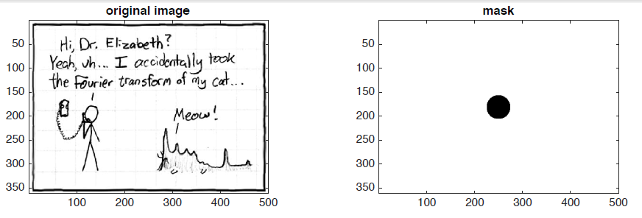
Fourier Filters (By Eye): 4

Slide 36
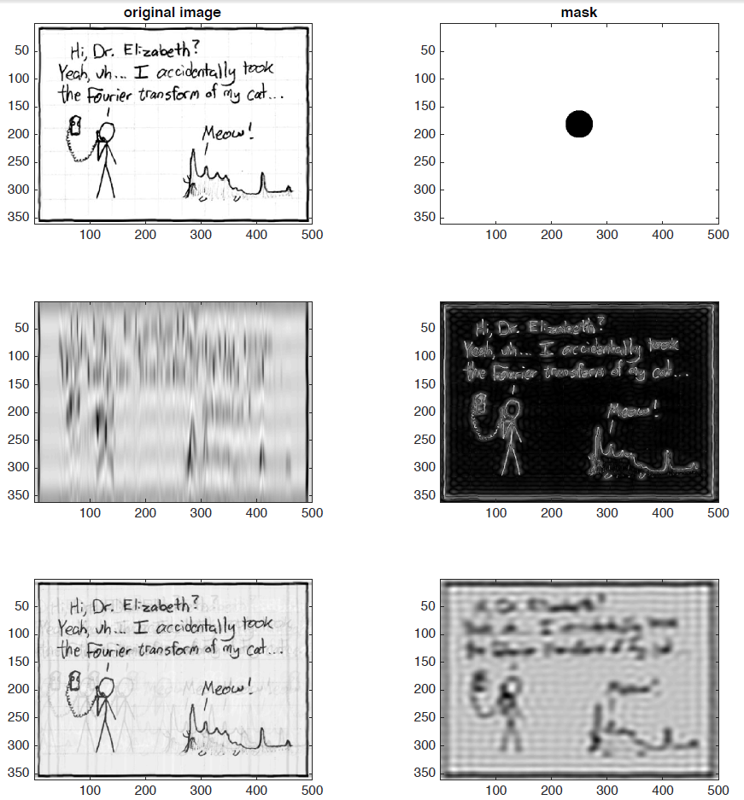
Fourier Filters (By Eye)

Slide 37
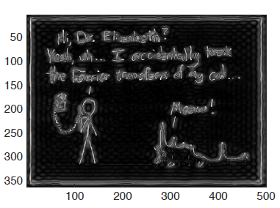
Fourier Filters (By Eye):4

Slide 38
Fourier Filters Bonus Question:1
Why did I use cartoons for all of these examples?

Slide 39

Gaussian Beams:1

Slide 40

Gaussian Beams:1

Slide 41

Gaussian Beams:2

Slide 42

Gaussian Beams:2

Slide 43
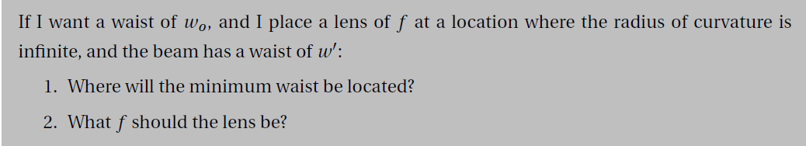
Gaussian Beams:3

Slide 44
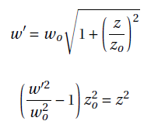
Gaussian Beams:3

Slide 45

Gaussian Beams:3

Slide 46
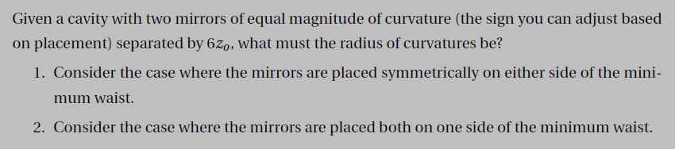
Cavities

Slide 47
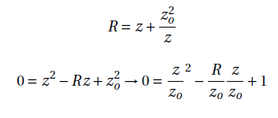
Cavities
Do on board

Slide 48
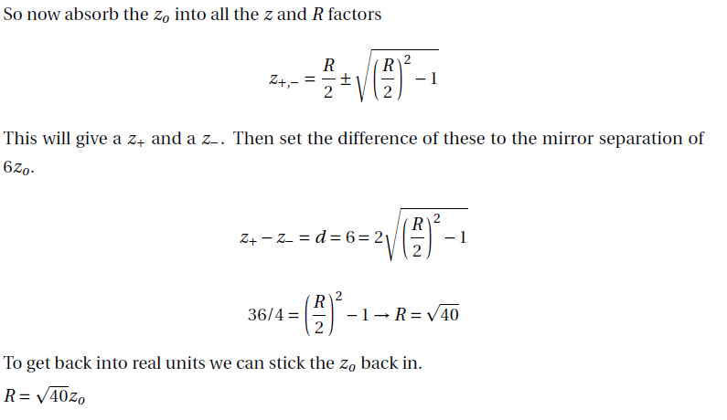
Cavities
Do on board

Slide 49
Polarization

Slide 50

Polarization
Do on board

Slide 51
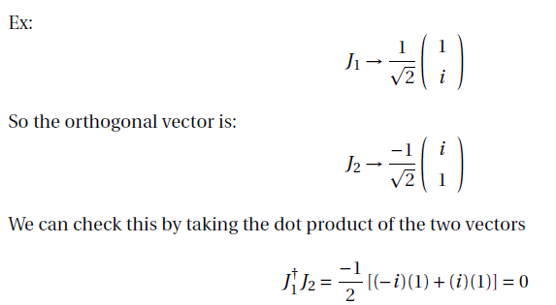
Polarization
Do on board

Slide 52

Polarization

Slide 53
Polarization
Write matrix on board

Slide 54
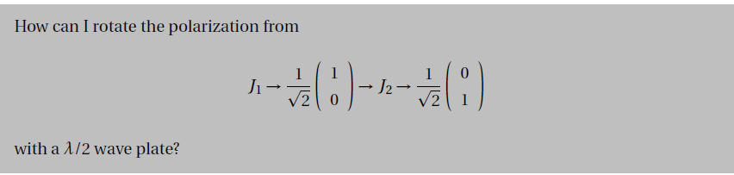
Polarization

Slide 55
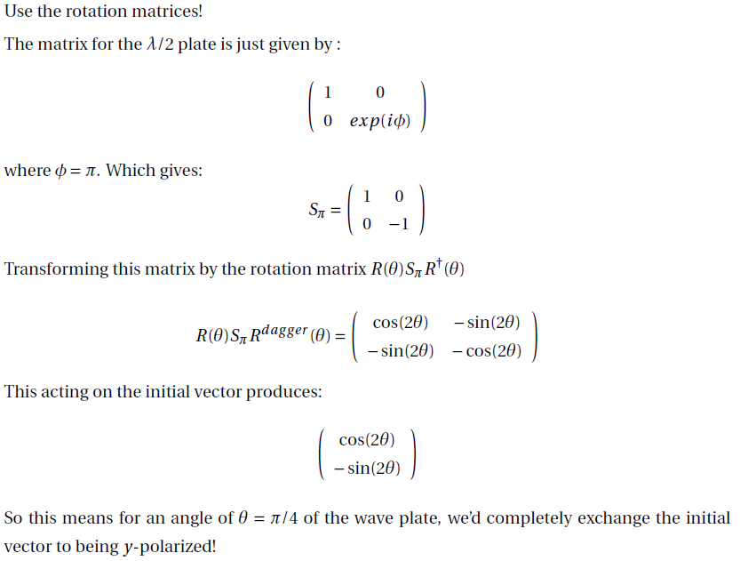
Polarization
Write matrix on board

Slide 56
Conceptual questions (TF):1

Slide 57
Conceptual questions (TF):2

Slide 58
Conceptual questions (TF):3

Slide 59
Conceptual questions (TF):4

Slide 60
Conceptual questions (TF):5

Slide 61
Conceptual questions (TF):6

Slide 62
Conceptual questions (TF):7

Slide 63
Conceptual questions (TF):8

Slide 64
Conceptual questions (TF):9

Slide 65
Conceptual questions (TF):10

Slide 66
Done!
Good luck on Friday!

